Slide 1


SOUTHWEST UNIVERSITY OF SCIENCE AND TECHNOLOGY
Topic:
Moroccan Restaurant Ordering System
School : | School of Computer Science and Technology
Name : | NOURDINE MOHAMED
Student ID : | 4420230912
Subject Name : | Web Interactive Design
Teacher Name : | MEMON MUHAMMAD HAMMAD 郝礼德
Date : | 2026-06-22

Slide 2

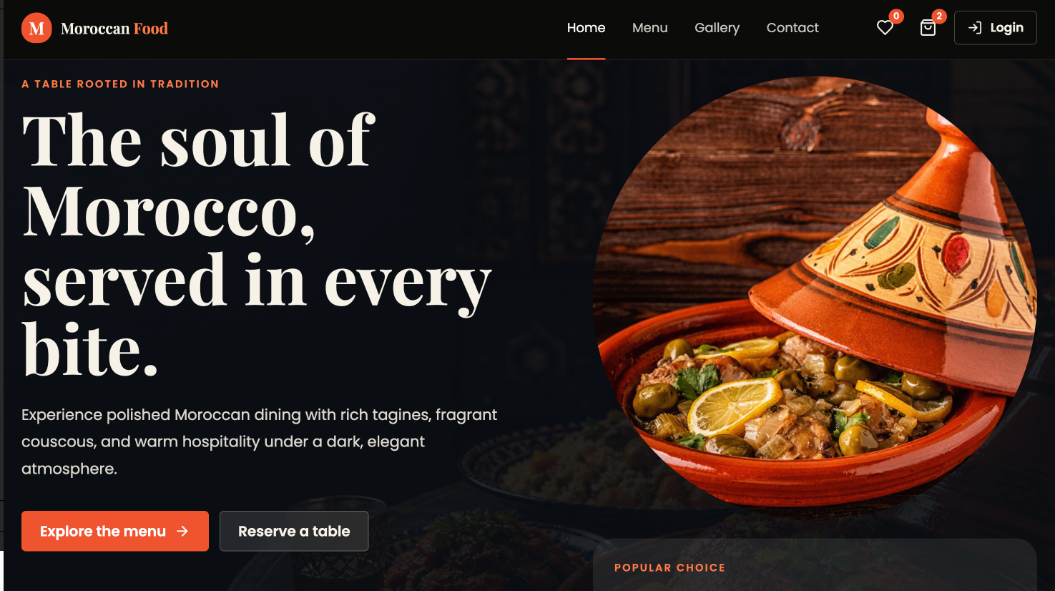
Introduction
Project Introduction
The Moroccan Restaurant Ordering System is a modern web-based platform developed to promote Moroccan cuisine and provide customers with a convenient online ordering experience.
Main Purpose
Allow customers to browse Moroccan dishes online.
Enable users to place food orders easily.
Provide an attractive and responsive interface.
Improve customer engagement through interactive features.
Technologies Used
HTML5
CSS3
JavaScript
React Framework
Local Storage
Benefits
Easy access to restaurant menu
Faster ordering process
Improved customer satisfaction
Mobile-friendly experience
"The project combines modern web technologies to create a complete online restaurant platform. It focuses on usability, responsiveness, and customer convenience."

Slide 3
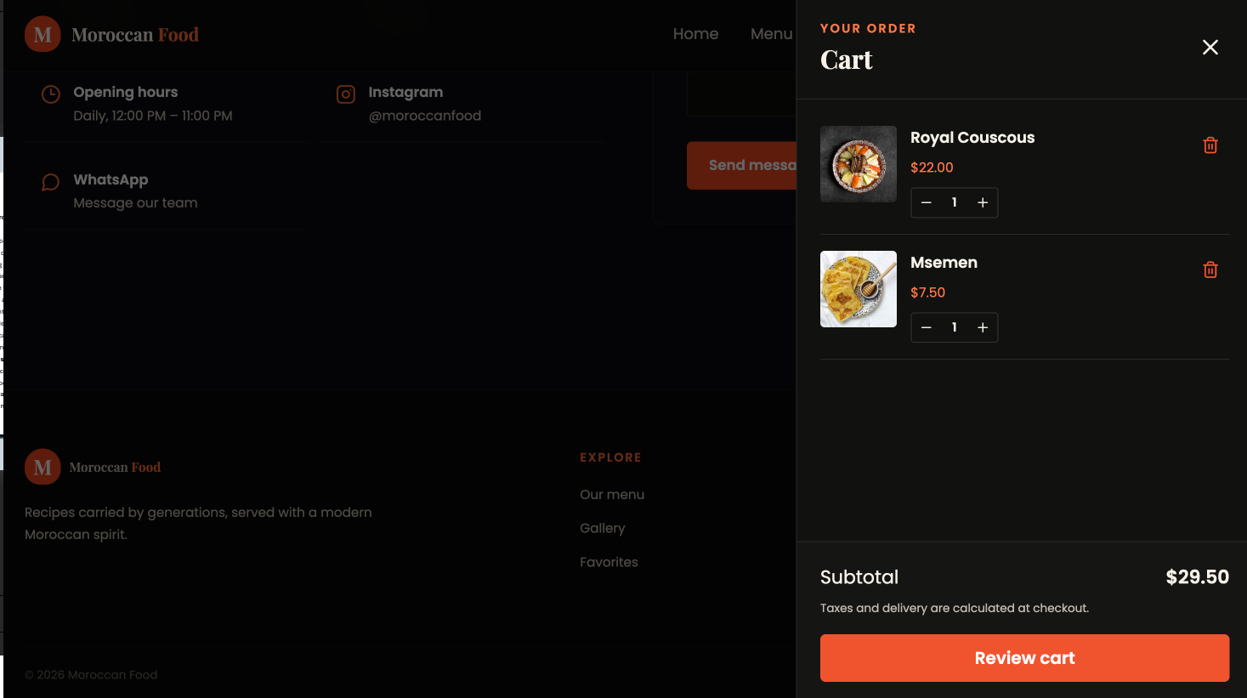
Project Objectives
Objectives of the Project
Primary Objectives
Develop a fully functional restaurant website.
Create a responsive design that works on all devices.
Implement shopping cart and checkout functionality.
Allow users to browse and search food items.
Enable users to save favorite dishes.
Provide secure login and registration features.
Improve customer interaction with the restaurant.
Apply modern web development techniques.
Demonstrate practical React development skills.
Produce a professional academic project.
Expected Outcomes
Better user experience
Efficient ordering process
Professional restaurant representation
Easy maintenance and scalability

Slide 4
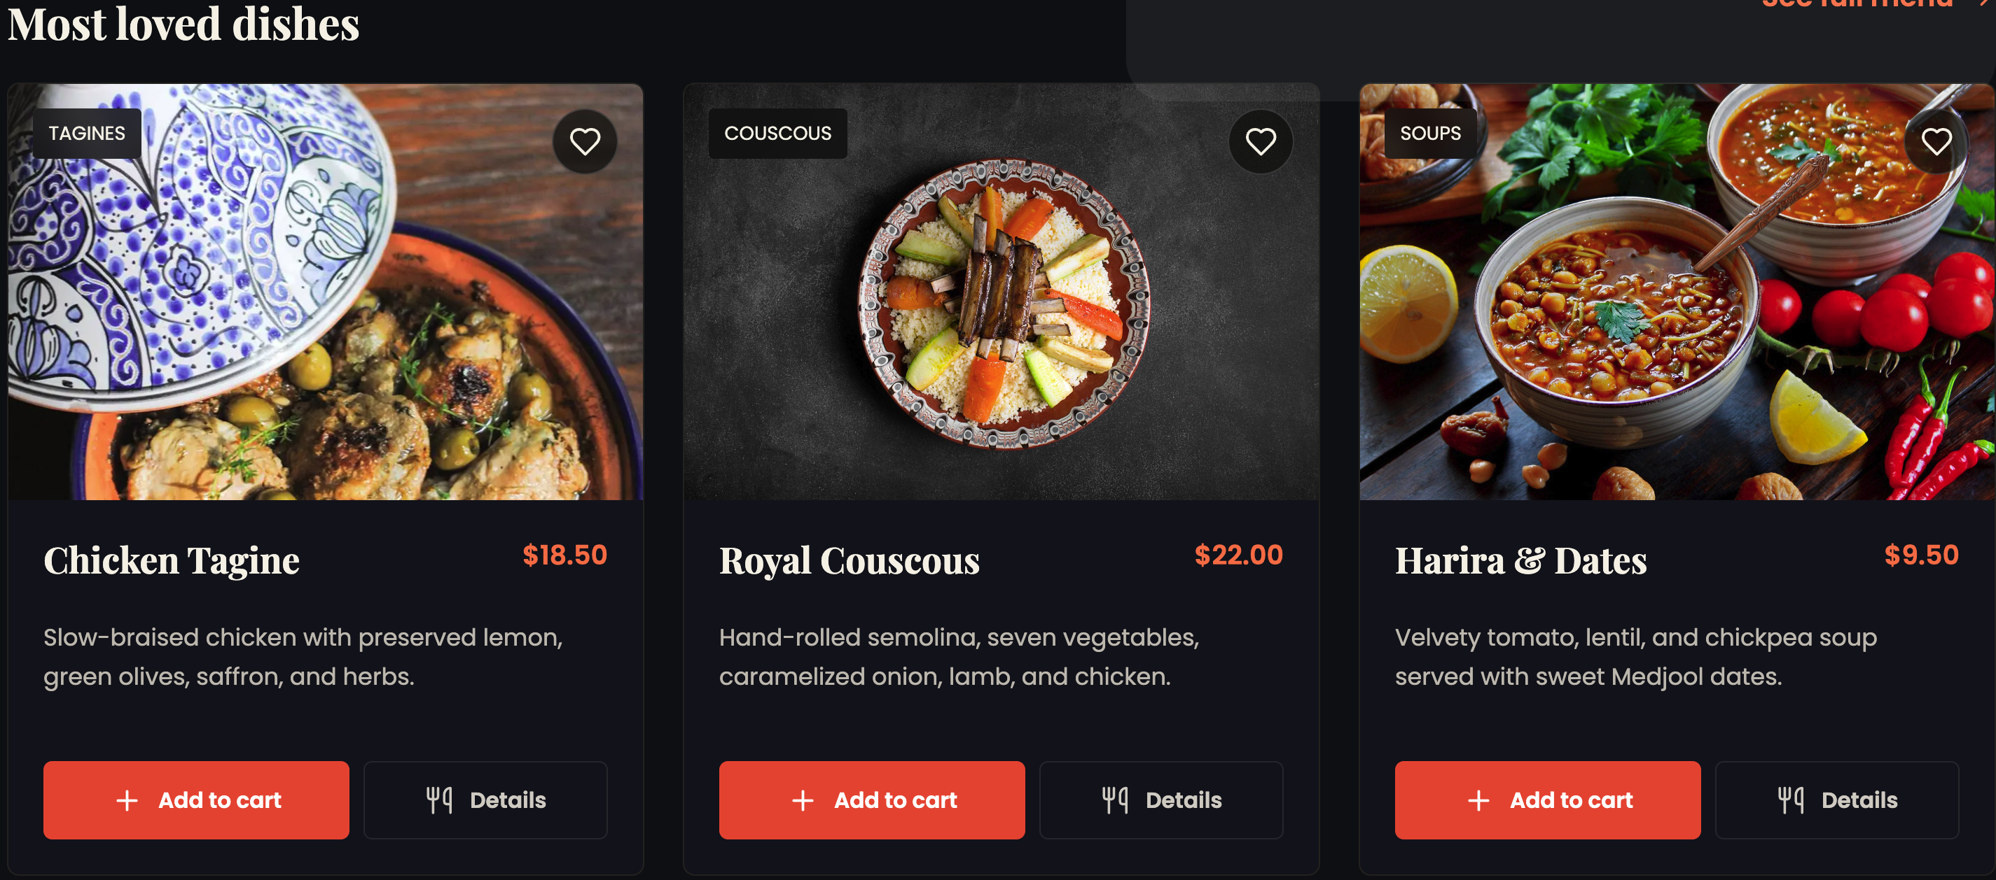
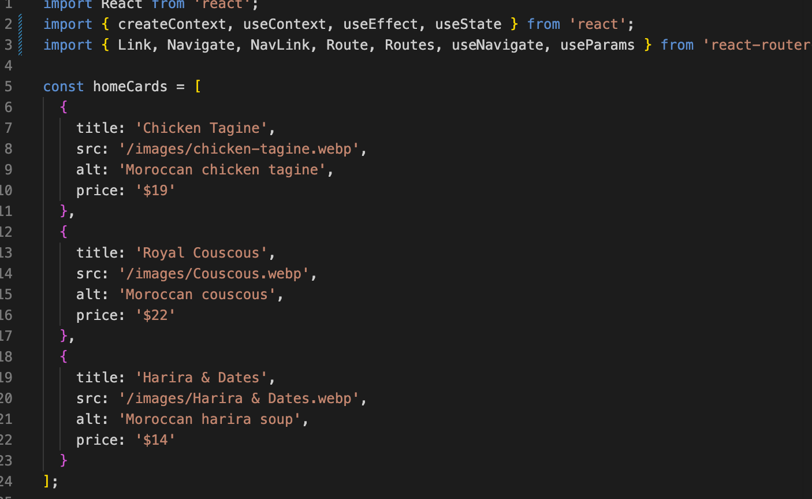
Requirement Analysis
Functional Requirements
The system provides the following features:
Customer Features
Homepage
Menu browsing
Food details page
Gallery
Contact page
User login and registration
Shopping cart
Checkout system
Favorites list
Order confirmation
Administrative Features
Menu management
Order management
Dashboard monitoring
Non-Functional Requirements
Performance
Fast page loading
Usability
User-friendly interface
Accessibility
Semantic HTML
Proper labels and navigation
Compatibility
Works on modern browsers
Scalability
Supports future expansion

Slide 5
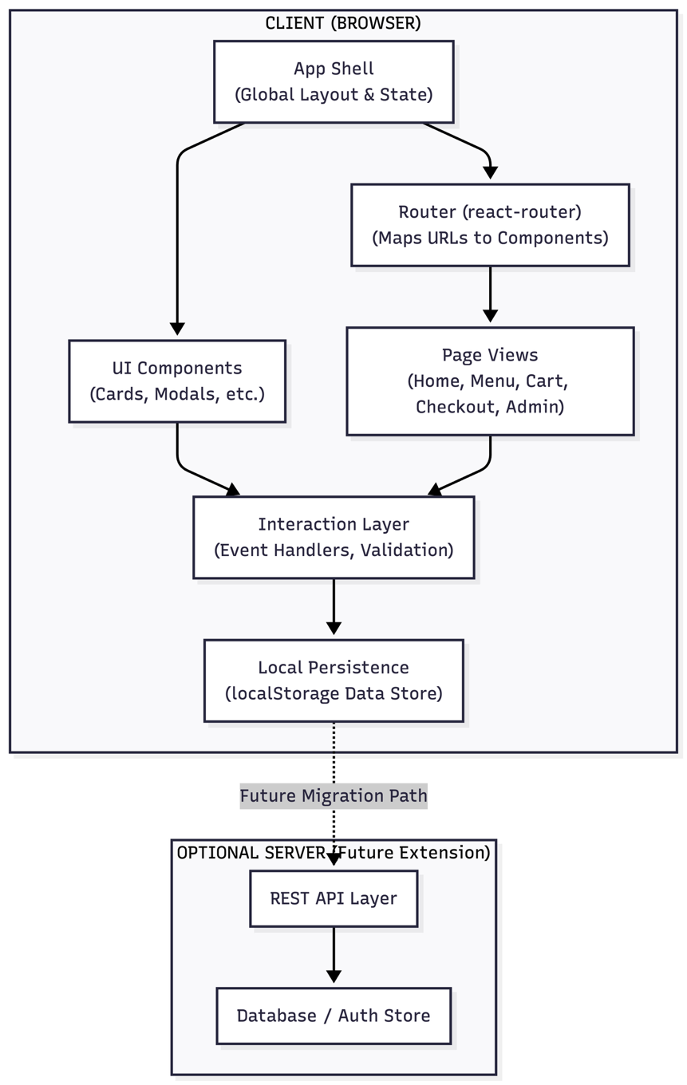
System Design
The application is built as a client-side Single Page Application (SPA) using React, JavaScript (JSX), HTML5, and CSS3. It leverages client-side routing for seamless page navigation and uses local browser storage to simulate a persistent data layer. The design isolates concerns into user interface rendering, interaction handling, and local state persistence to maximize testability and adhere to clean code structures.

Slide 6
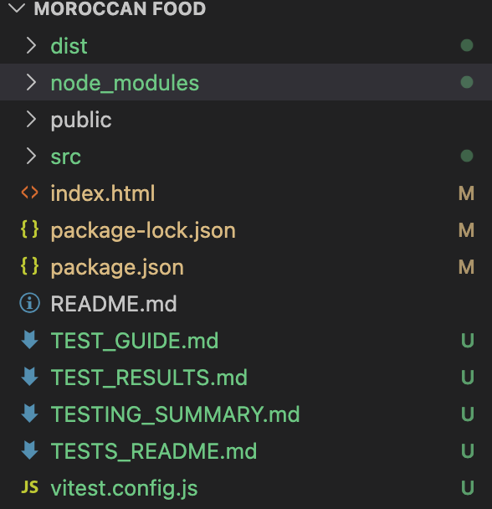
System Architecture
Architectural Overview
The application follows a Single Page Application (SPA) architecture.
Main Components
User Interface Layer
Displays pages and components
Handles user interaction
Routing Layer
Controls navigation between pages
Uses React Router
Business Logic Layer
Processes user actions
Validates forms and data
Data Storage Layer
Uses browser localStorage
Stores cart and order information
Advantages
Faster performance
Better user experience
Reduced page reloads
Easy maintenance
Folder/File | Purpose
src | Application source code and components
public | Images and static assets
dist | Production build files
index.html | Main HTML entry point
package.json | Project dependencies and scripts
vitest.config.js | Testing configuration
TEST_GUIDE.md | Testing documentation
TEST_RESULTS.md | Test results summary

Slide 7
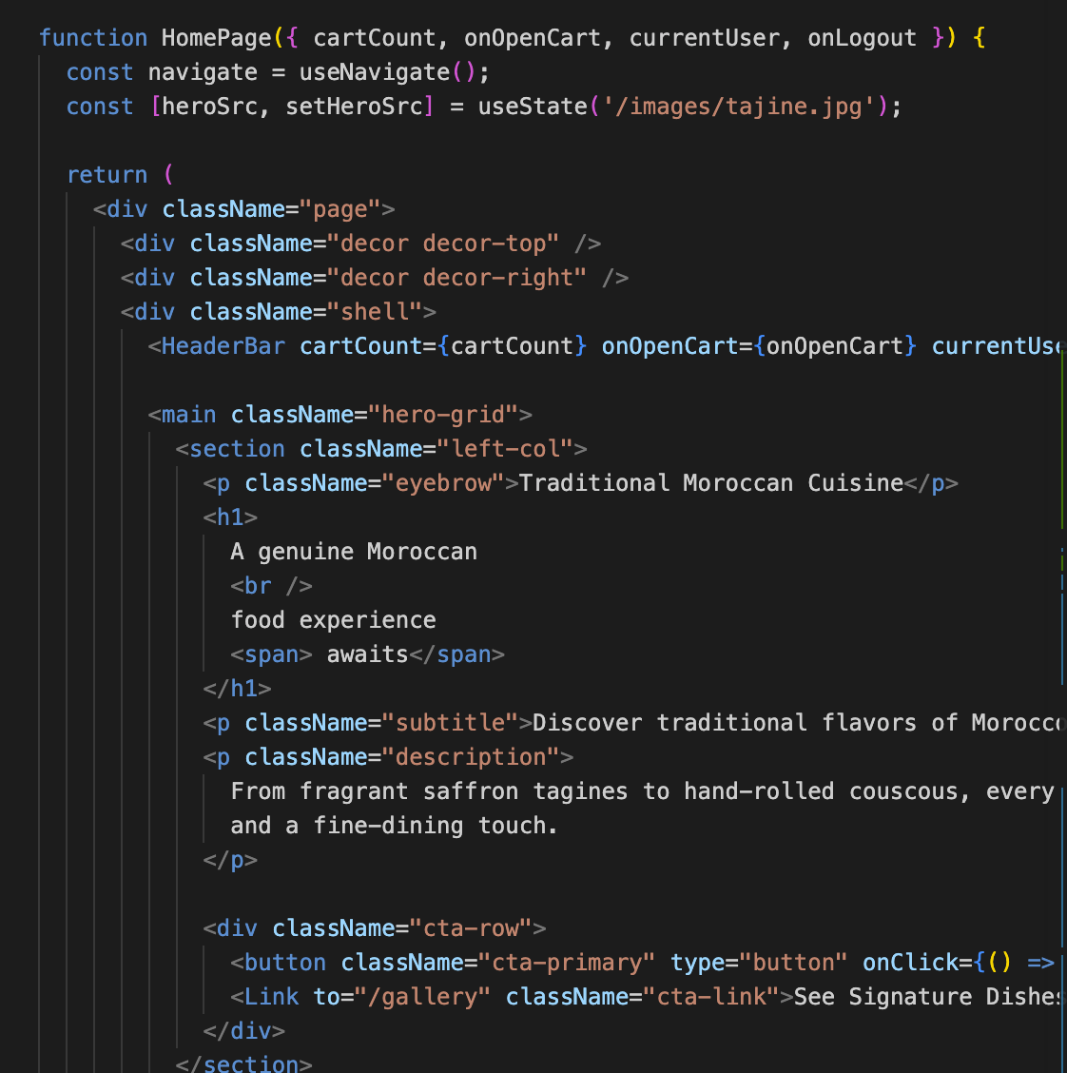
Core System Components
App Shell & Router
Controls page navigation
Manages application layout
Page Views
Home Page
Menu Page
Contact Page
Checkout Page
Cart Sidebar
Displays selected items
Updates quantities
Data Store
Stores:
  Orders
  Cart items
  Favorites
Utility Functions
Form validation
Data filtering
Error handling
Benefits
Modular architecture
Reusable code
Easier debugging

Slide 8
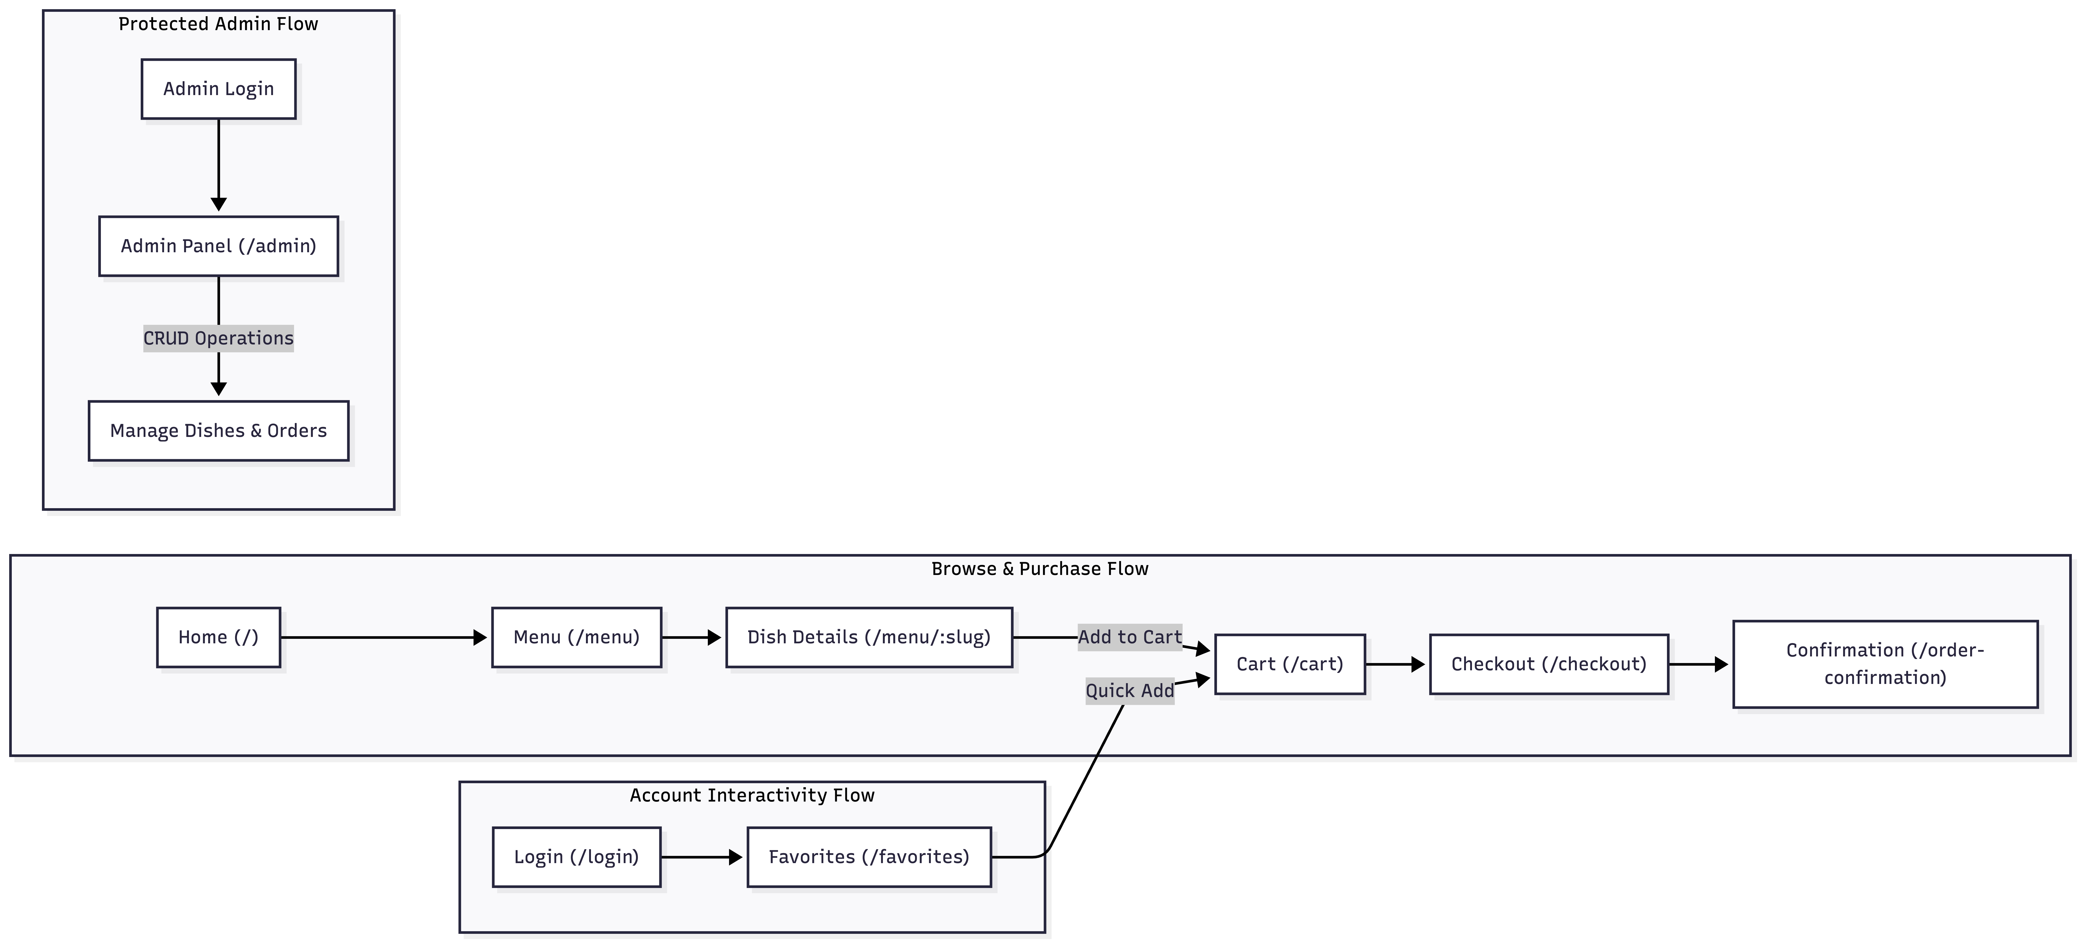
Website Structure
Project Architecture
Built using React + Vite
Uses React Router DOM for navigation
Single Page Application (SPA)
Centralized application logic in App.jsx
Global styling managed through styles.css
Browser Local Storage used for data persistence
The website follows a Single Page Application structure built with React and React Router. Customers can browse the menu, view dish details, add items to the cart, complete checkout, and track orders. Additional pages such as Gallery, Favorites, Profile, and Admin Dashboard provide a complete restaurant management and customer experience system."

Slide 9
Implementation
Implementation Patterns & Page Shell Scaffolding
Core Technology Stack
React.js – Frontend Framework
Vite – Build Tool
React Router DOM – Navigation & Routing
HTML5 – Structure
CSS3 – Styling & Responsive Design
JavaScript (ES6+) – Interactivity & Logic
// Target Page Component structure within App.jsx or src/pages/Home.jsx
export default function Home() {
return (
<>
<header>
<nav>...links...</nav>
</header>
<main>
<section className="hero">...</section>
<section className="featured">...</section>
</main>
<footer>...contact & links...</footer>
</>
);
}
The implementation is based on React and Vite. The application entry point is .jsx, which loads App.jsx through BrowserRouter. App.jsx manages routing, application state, and UI components. React Router handles page navigation, while state management controls cart operations, user authentication, favorites, and order processing

Slide 10
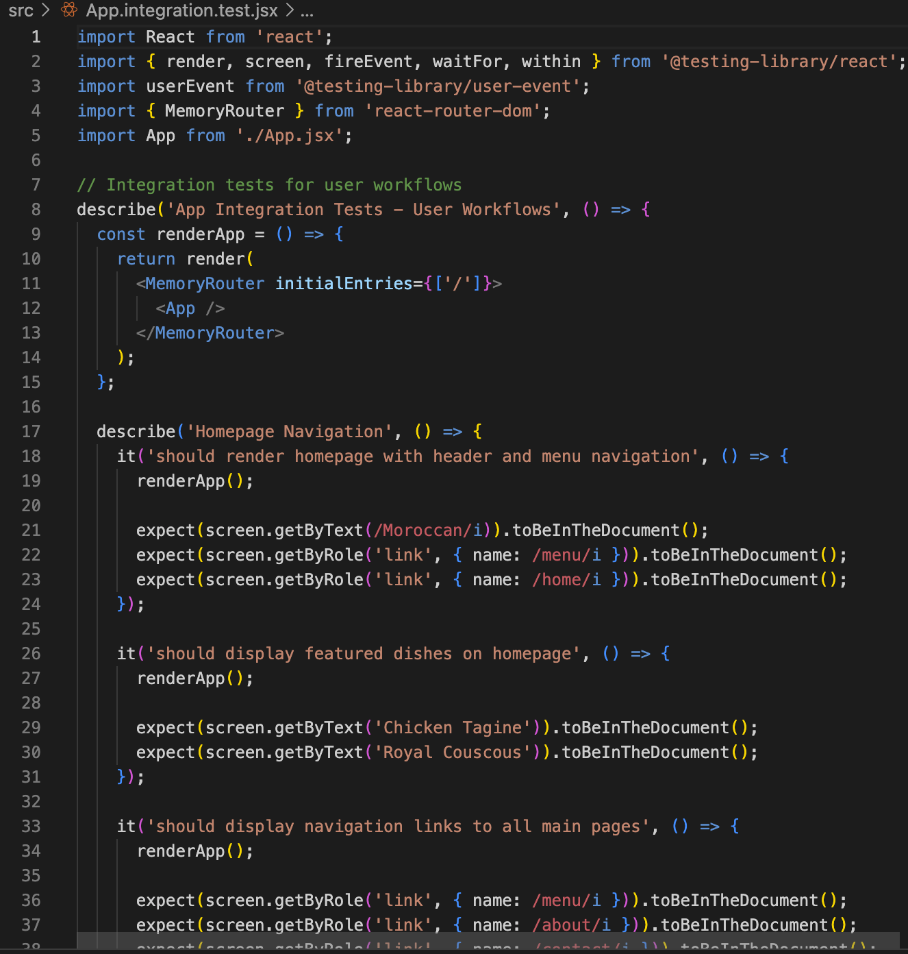
Testing & Evaluation
Comprehensive testing was performed on the Moroccan Food Website.
Both Unit Testing and Integration Testing were conducted.
Core functionalities were verified successfully.
Testing tools used:
  Vitest
  React Testing Library
  jsdom
Features Tested:
User Authentication
Shopping Cart
Menu Search & Filtering
Favorites System
Checkout Process
Order Management
Admin Dashboard
Data Persistence

Slide 11
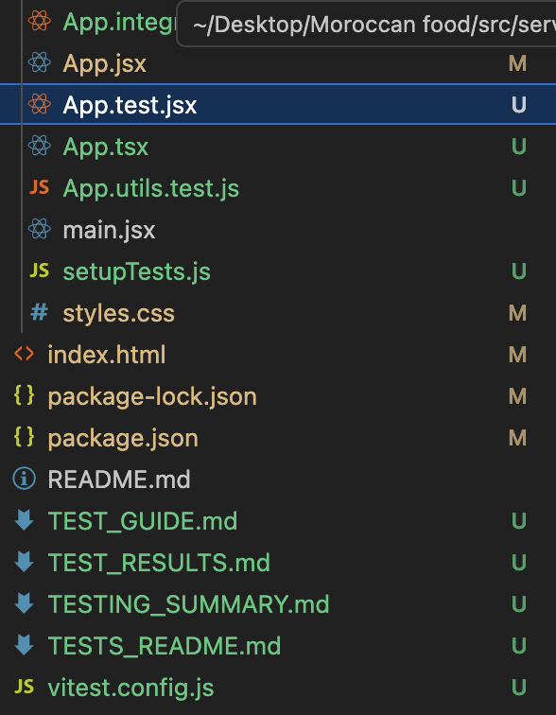
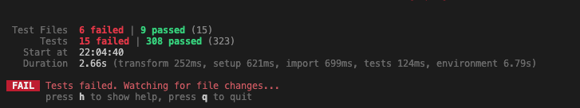
Conclusion
All critical business functionalities passed testing.
Authentication, cart management, checkout, and order processing worked correctly.
Minor failures were related to component rendering and routing configuration.
Overall system reliability and performance were successfully validated.
This gives you exactly 2 professional testing slides, with the screenshot placed on the second slide.
Testing Results
Metric | Result
Total Tests | 323
Passed Tests | 308
Failed Tests | 15
Pass Rate | 95%

Slide 12
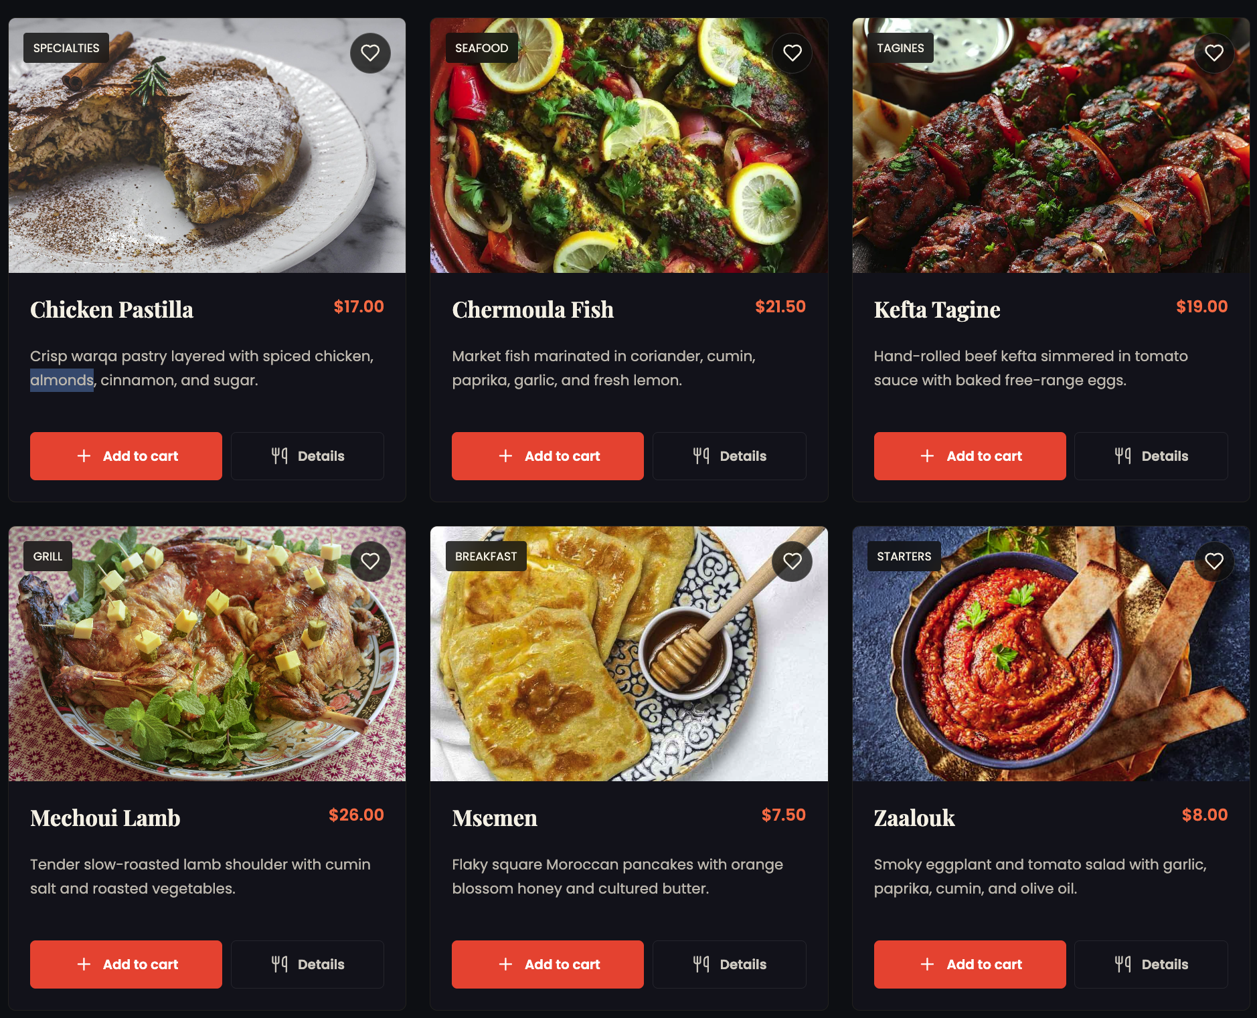
Results & Achievements
Project Outcomes
The Moroccan Restaurant Ordering System successfully achieved its objectives by delivering a modern, responsive, and user-friendly web application.x
Key Achievements
✅ Developed a complete restaurant ordering platform
✅ Implemented responsive design for all devices
✅ Created an interactive shopping cart system
✅ Added favorites and order management features
✅ Implemented user authentication
✅ Developed an admin dashboard for management
✅ Applied modern React development practices

Slide 13
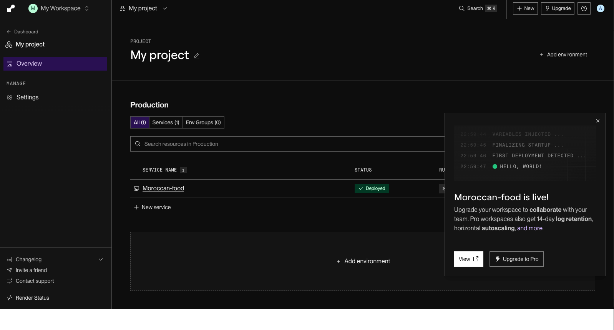
Deployment
Deployment Process
Created a GitHub repository.
Uploaded the project source code.
Connected the repository to Render.
Configured build and deployment settings.
Deployed the application online.
Tested the deployed website.
Benefits
Accessible from anywhere through a web browser.
Easy project demonstration and presentation.
Automatic deployment of updates.
Reliable cloud hosting.
Deployment Status
✅ Successfully Deployed and Fully Functional
Deployment Platform
The Moroccan Food Website was deployed using Render.
Render provides reliable cloud hosting for modern web applications.
Live Website
https://moroccan-food.onrender.com
Source Code Repository
https://github.com/NOURDINED-MED/Moroccan-food

Slide 14
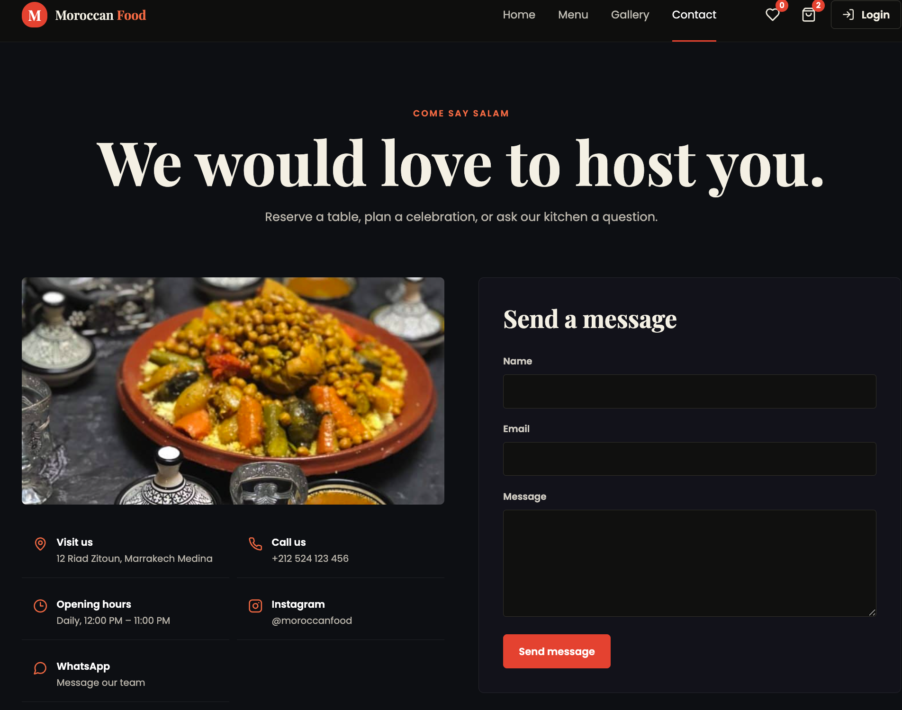
Conclusion & Future Work
Conclusion
The Moroccan Restaurant Ordering System successfully achieved all project objectives and provides a complete online food ordering experience.
Project Summary
using React, JavaScript, HTML5, and CSS3
Implemented resDevelopedponsive and modern user interface
Integrated shopping cart and checkout functionality
Provided user authentication and order management
Applied component-based architecture for maintainability
Successfully passed functional and responsive testing

